Slide 1

PUBLIC VEHICLE COMPLAINT MANAGEMENT SYSTEM
By: Amit, John Mark
Gula, Jose Maria
Melchor, Alec
Ybañez, Vanvan

Slide 2




SYSTEM OVERVIEW

Slide 3

CHAPTER 1
INTRODUCTION

Slide 4


Slide 5

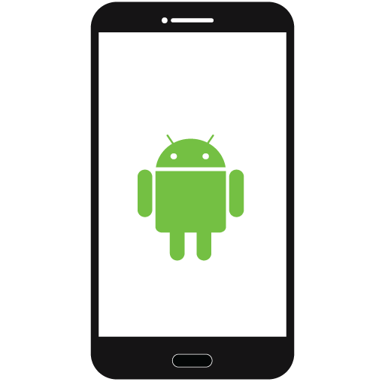

GENERAL OBJECTIVE

Slide 6


SPECIFIC OBJECTIVES
Determine common complaint violations regarding
Public vehicles.
Design mobile-based complaint submission.
Design a complaint handling web application.
Develop a public vehicle complaint management system.
Test and evaluate the system.

Slide 7




SIGNIFICANCE OF THE STUDY
COMPLAINANT
OPERATOR
LTFRB & LTO
OTHER RESEARCHERS

Slide 8
SCOPE AND LIMITATIONS
Complainants can submit public vehicle complaints.
Admin (operators) can verify complaints, manage vehicles, manage drivers and generate reports.
Super admin (LTFRB) can verify complaints, manage operators and view all the records.
Only android smartphones can use this system.
The system requires stable internet connection.
Only common violations and LTO violations
SCOPE
LIMITATIONS

Slide 9
CHAPTER 2
SUMMARY OF
RELATED SYSTEMS

Slide 10
SUMMARY OF RELATED SYSTEMS
Main concepts of the related systems:
Systematized gathering of feedback from people through online crowdsourcing.
Assessment of public transportation quality through feedback.
Systematized performance monitoring of public vehicle drivers.

Slide 11
CHAPTER 3
TECHNICAL
BACKGROUND

Slide 12






TECHNICAL BACKGROUND

Slide 13
CHAPTER 4
DESIGN AND
METHODOLOGY

Slide 14
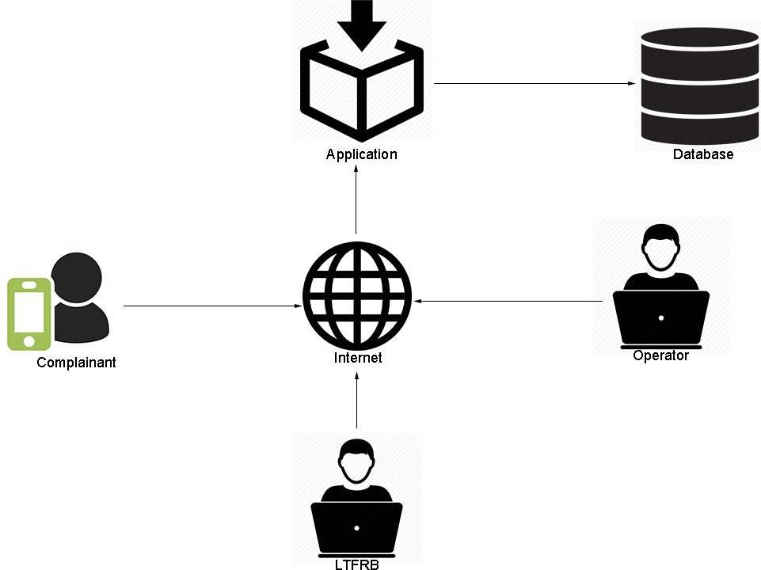
CONCEPTUAL FRAMEWORK

Slide 15
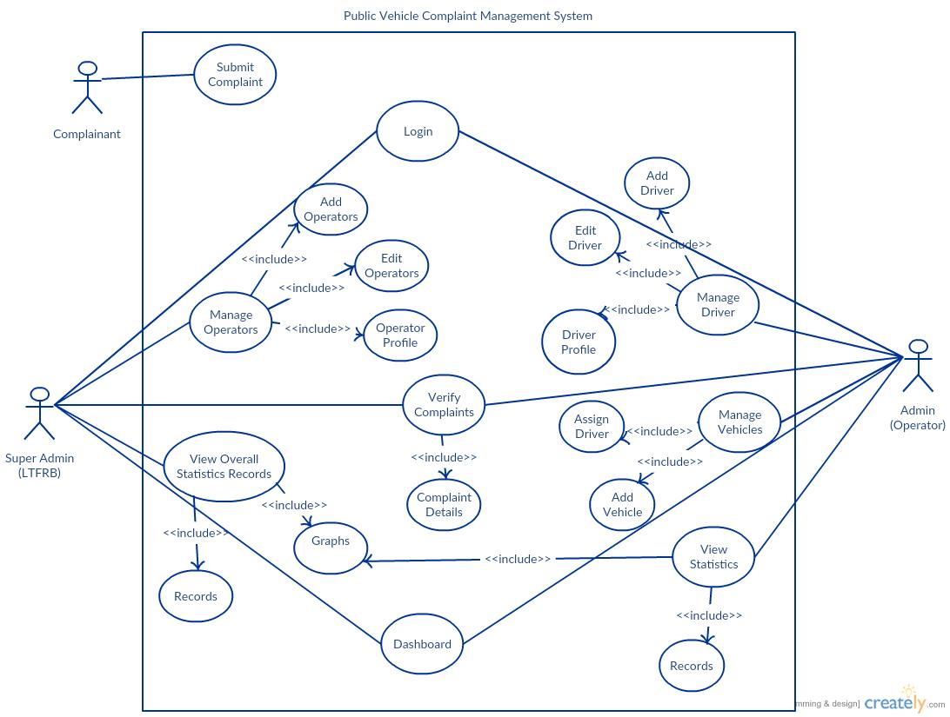
USE-CASE DIAGRAM

Slide 16
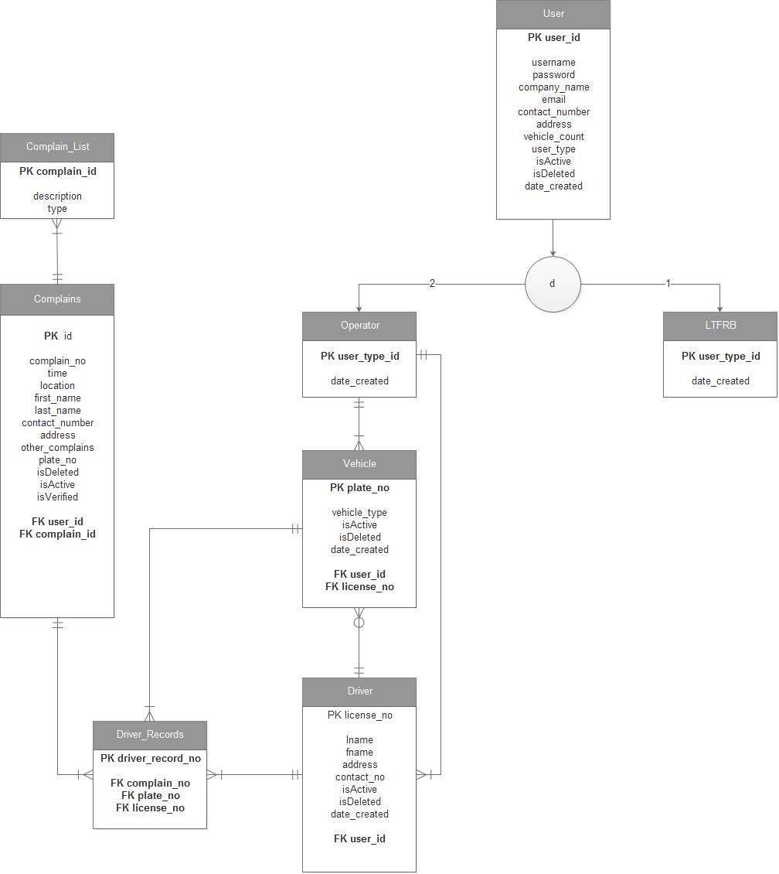

Slide 17
CHAPTER 5
RESULT AND
ANALYSIS

Slide 18
SPECIFIC
OBJECTIVE 1

Slide 19
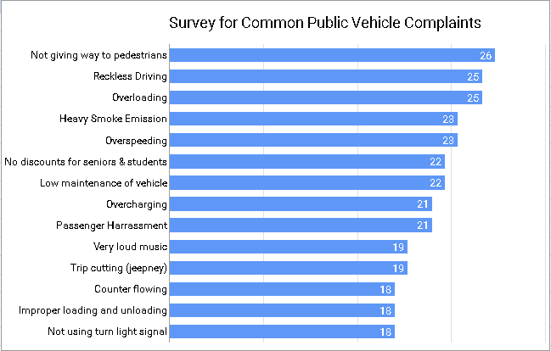
DETERMINE COMMON COMPLAINTS
AND VIOLATIONS REGARDING PUBLIC VEHICLES

Slide 20
SPECIFIC
OBJECTIVE 2

Slide 21
DESIGN A MOBILE-BASED COMPLAINT SUBMISSION
The researchers achieved the second objective by designing a mobile application, the applications capabilities include:
Get city location of complainant.
Get personal information of complainant
Submit complaint(s) to a vehicle by vehicle plate number.

Slide 22
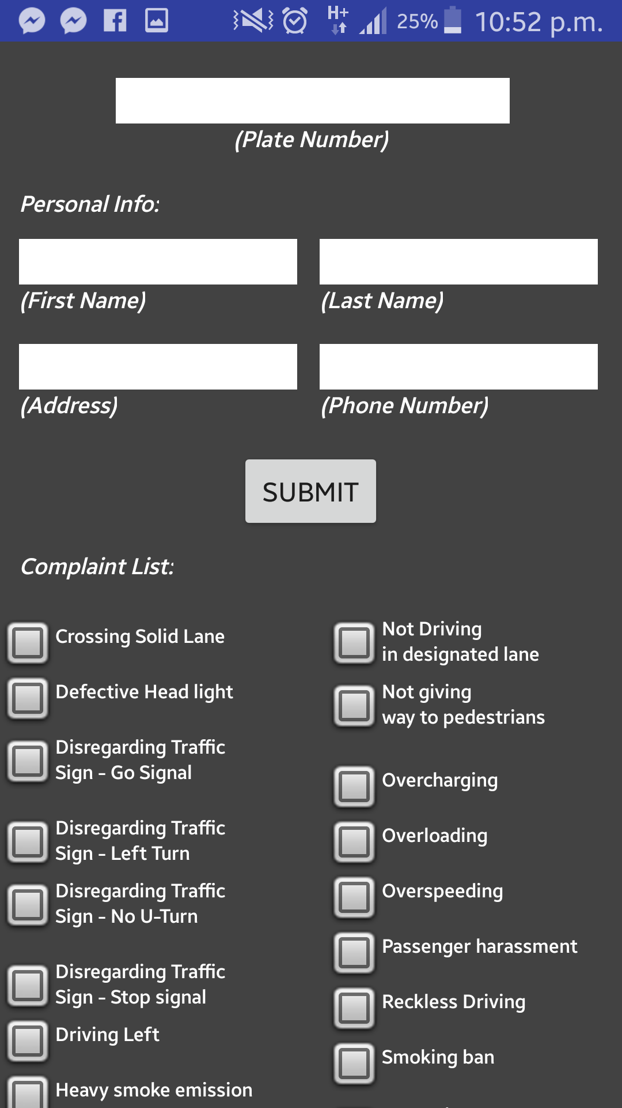
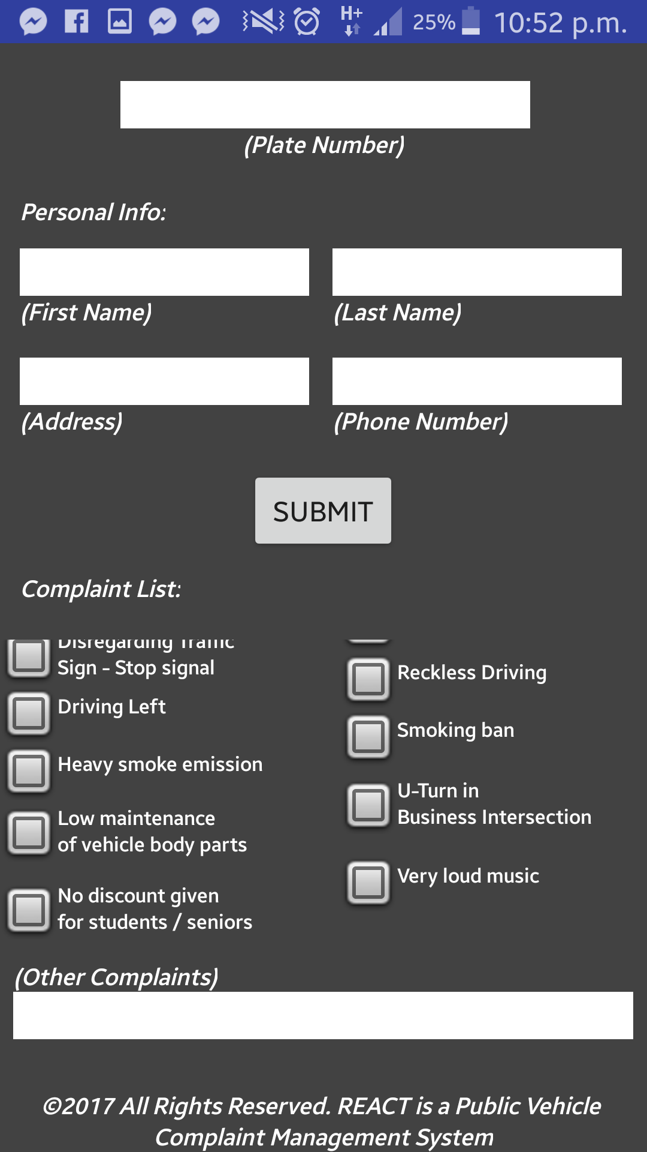
DESIGN A MOBILE-BASED COMPLAINT SUBMISSION

Slide 23
SPECIFIC
OBJECTIVE 3

Slide 24
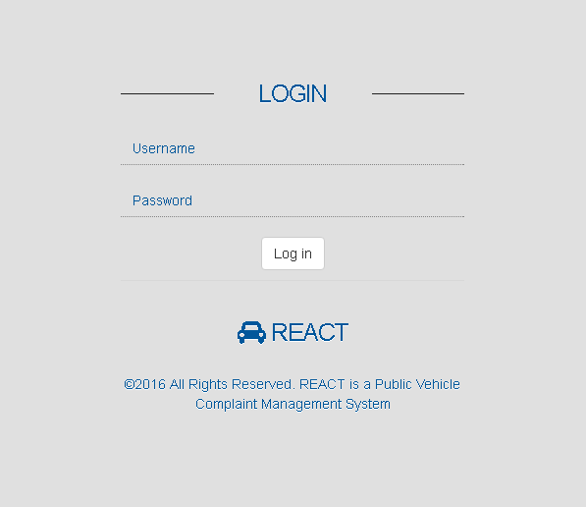
DESIGN A COMPLAINT HANDLING WEB APPLICATION

Slide 25
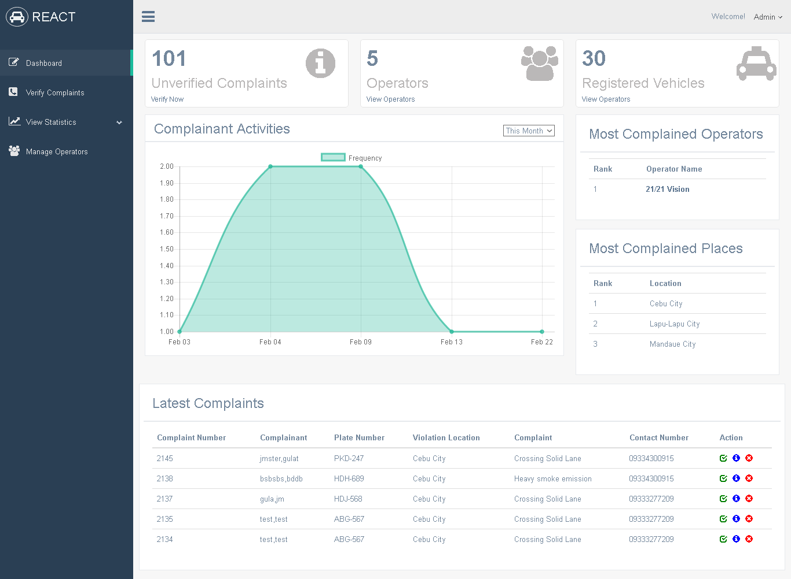
SUPER ADMIN DASHBOARD

Slide 26
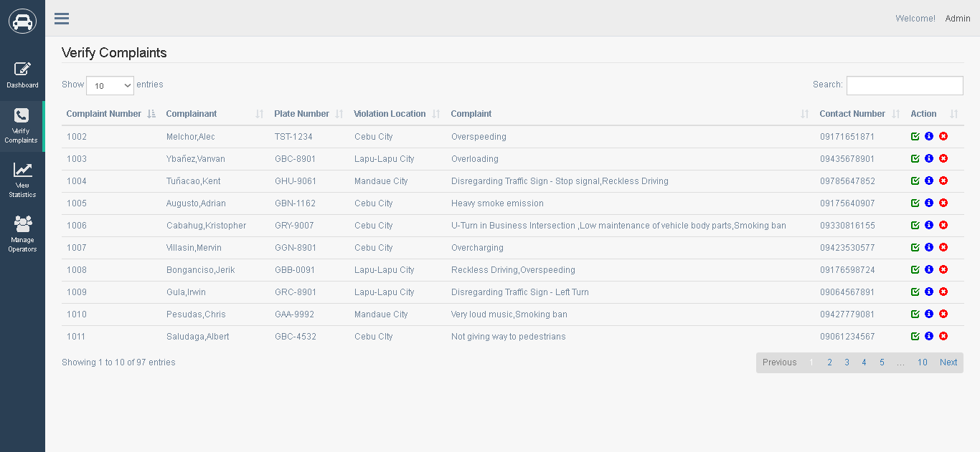
SUPER ADMIN VERIFY COMPLAINTS

Slide 27
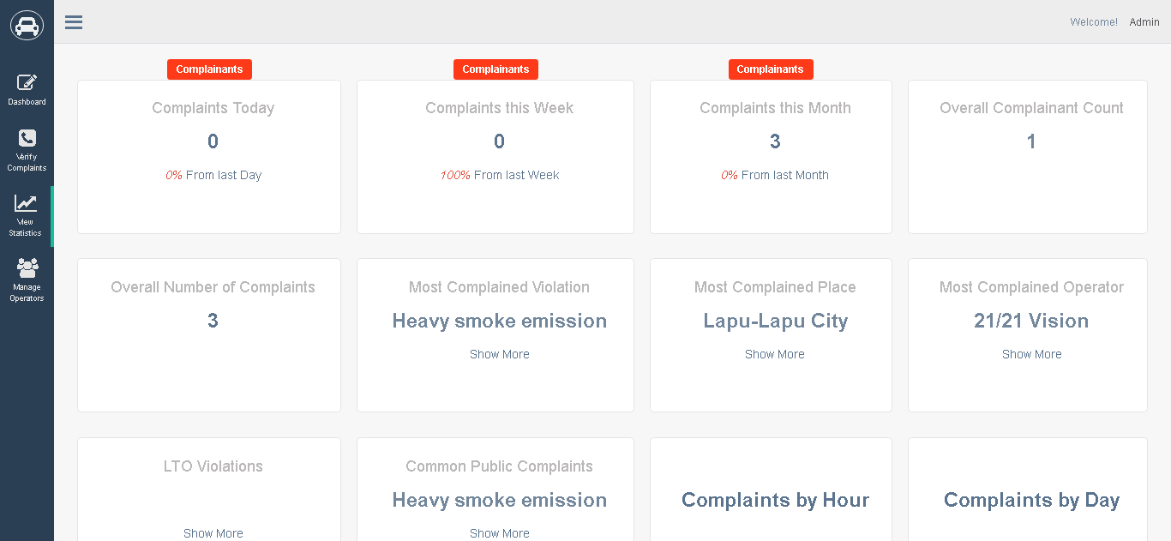
SUPER ADMIN VIEW RECORDS

Slide 28
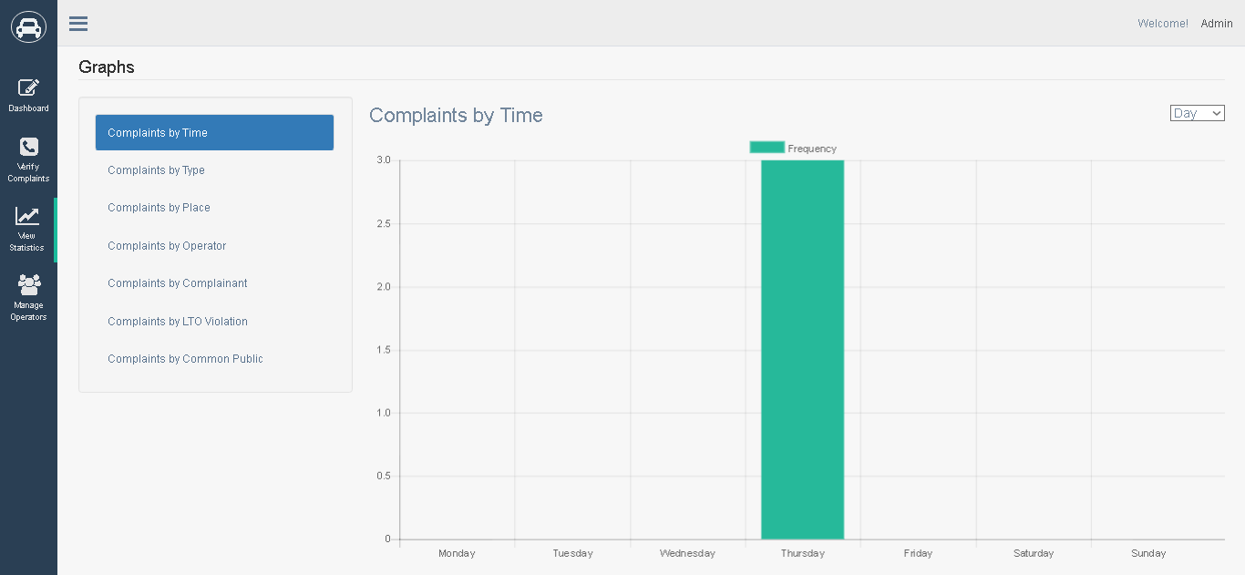
SUPER ADMIN VIEW GRAPHS

Slide 29
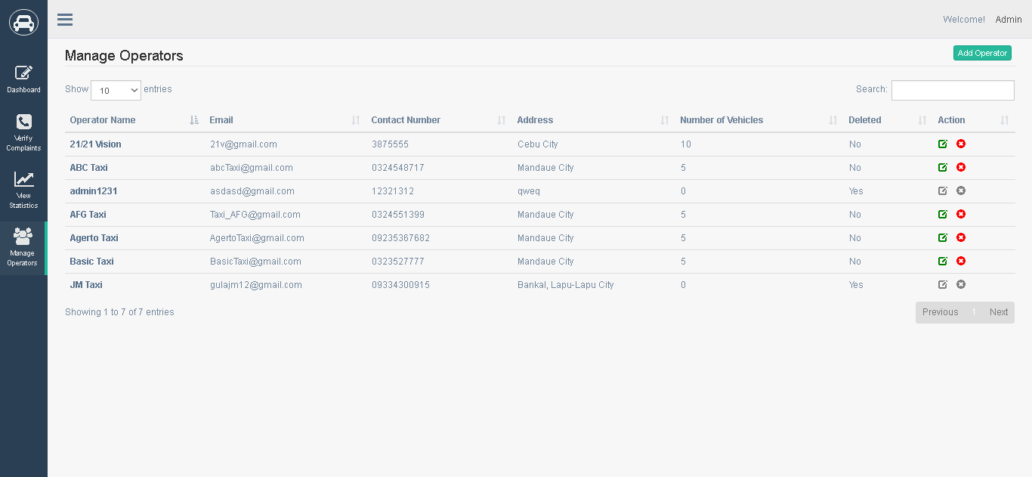
SUPER ADMIN MANAGE OPERATORS

Slide 30
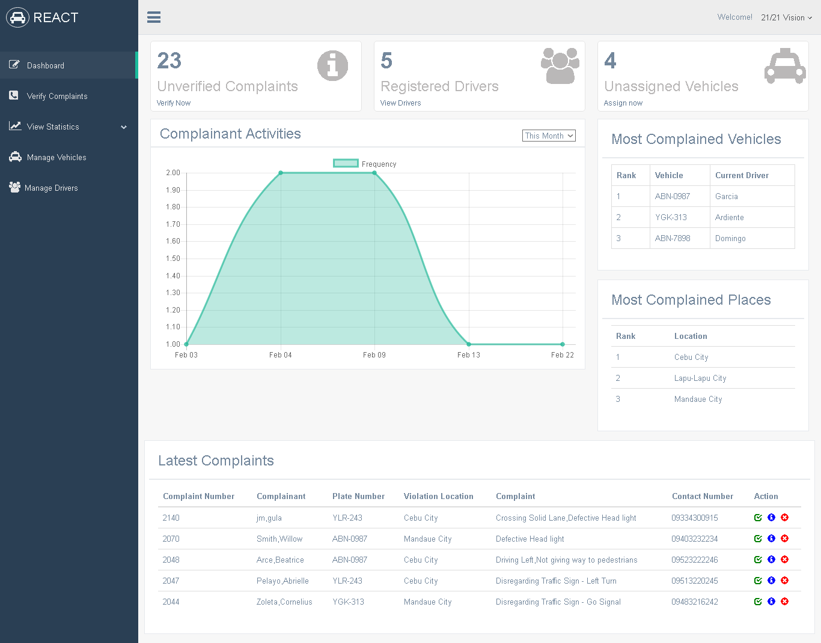
ADMIN DASHBOARD

Slide 31
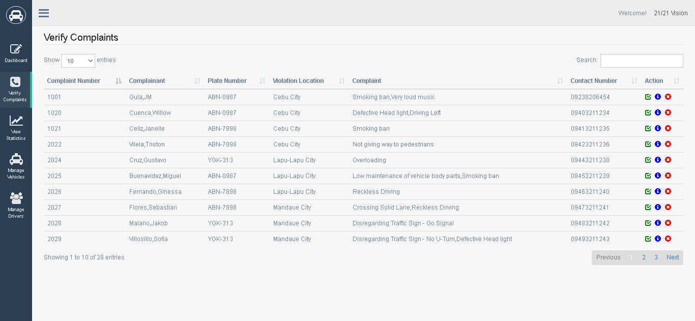
ADMIN VERIFY COMPLAINTS

Slide 32
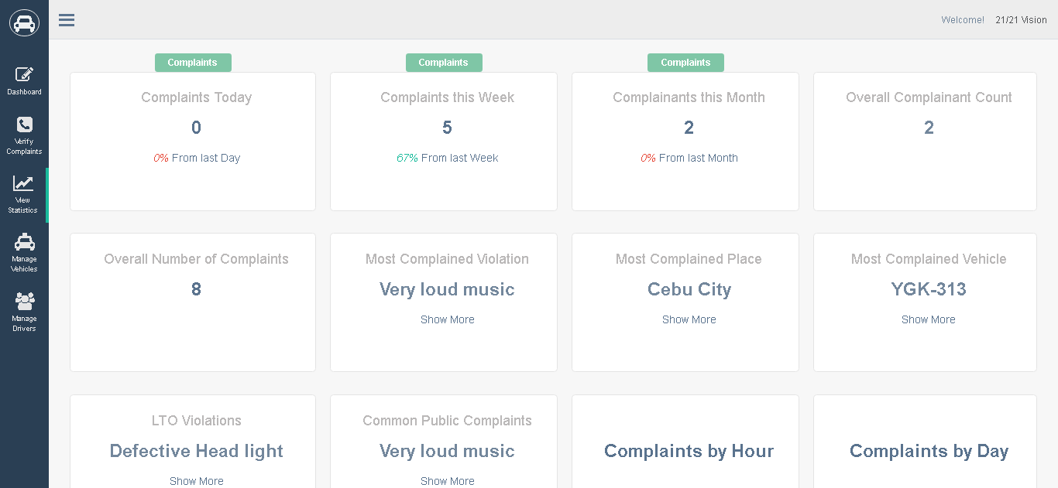
ADMIN VERIFY VIEW RECORDS

Slide 33
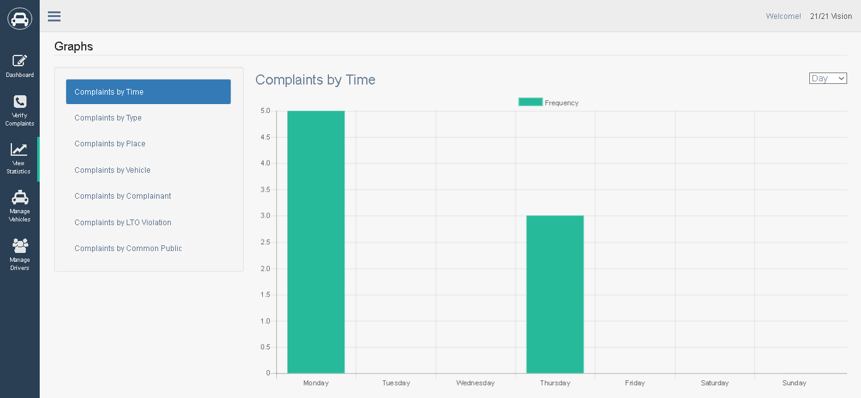
ADMIN VERIFY VIEW GRAPHS

Slide 34
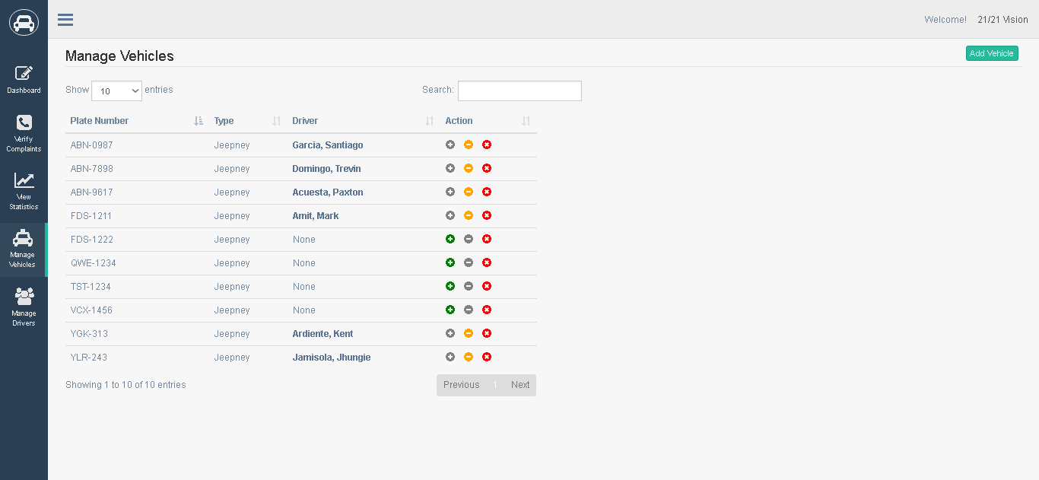
ADMIN MANAGE VEHICLES

Slide 35
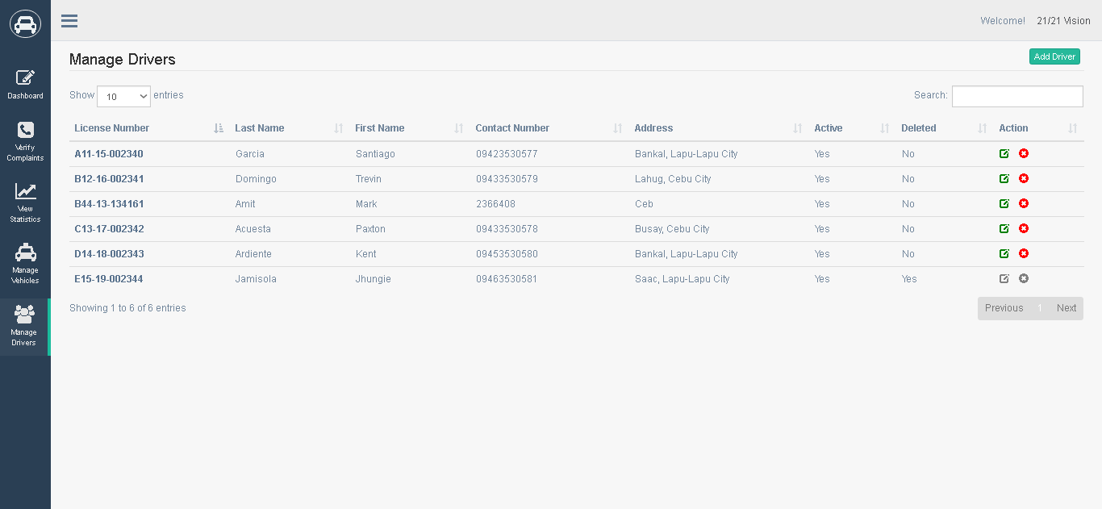
ADMIN MANAGE DRIVERS

Slide 36
SPECIFIC
OBJECTIVE 4

Slide 37
DEVELOP A PUBLIC VEHICLE COMPLAINT MANAGEMENT SYSTEM

Slide 38
SPECIFIC
OBJECTIVE 5

Slide 39
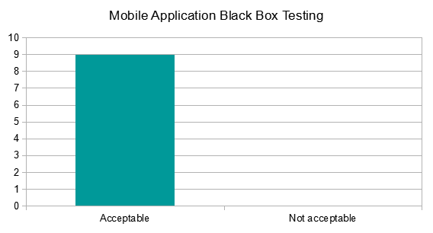
TEST AND EVALUATE THE SYSTEM
Black Box Testing

Slide 40
TEST AND EVALUATE THE SYSTEM
User Acceptance Testing

Slide 41
CHAPTER 6
CONCLUSION
AND
RECOMMENDATION

Slide 42
CONCLUSION
From the design phase until the system had been tested, the researches have come up with the following conclusions:
The system demonstrates the possibility of sending public vehicle complaints on an android device that will be received and verified by operators and government transportation authorities. By using the system the verified complaints received by the operators and the LTFRB authorities will be beneficial to the public.

Slide 43
RECOMMENDATION
For future researchers, a good recommendation is the implementing of a real-time mobile application to web application connectivity. Another good recommendation would be the implementation of a good file hosting feature for seamless submission of complaints.

Slide 44
END

